Slide 1
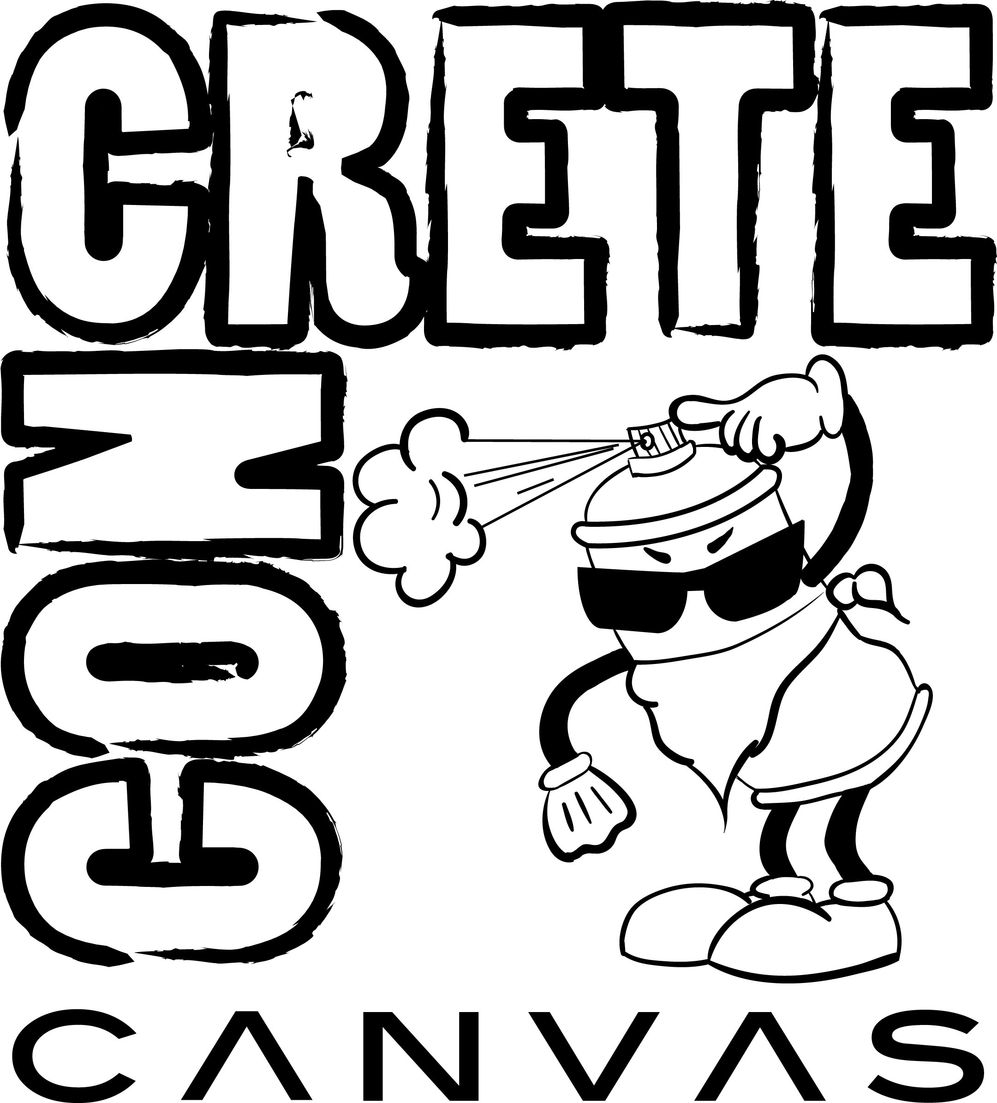

Slide 2
Genre
Arcade and graphical display.
The concept of the game was derived from retro style games like Pac-man, Bomber man. The grid like features we wish to implement into the game was taken from Pokémon (Gameboy versions).

Slide 3
System requirements
PC/Mac.
Mouse keyboard
Potential port to android devices

Slide 4
Game story
Santa Chroma, California. It was once a thriving city with a renowned artistic community. Self-expression, individuality and free thinking was encouraged and celebrated. It all came to an end once Norman Graytone was elected as the new mayor. Under the guise of a safer environment for everyone, Mayor Graytone enacted proposition K-50, every form of art that was seen as subversive. Seeing self-expression as a threat to order, the proposition also mandated that every building, public and private, be painted gray. Little did Mayor Graytone knew, that his regime was prepping the canvases for a new art movement...

Slide 5
Game mechanics
A grid is set down for placement of all scenery, items and movement.
Characters, enemy and player, are allowed to interact with the environment.
User can pick up variety of different power-ups to help traverse the grid faster.
The player has to “beautify” the world around them.
Time limit to colorize the map and complete given objectives
Enemy AI was implemented through Q-Learning

Slide 6
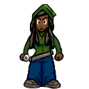
Player
The player is to traverse through the grid of the city/landscape and paint the objectives.
Several power-ups will be available to for pickup.

Slide 7
Enemy (security guard/ police officer)
This enemy walks through the grid. Can spot any changes made, “color” added to their world.
This enemy can call for assistance. Direct the a painter to access areas where colorization was done, and have the painter repaint the area(s) back to its original grey tone.
Police officer/Security Guard cannot paint over anything. Must call painter to paint over anything.

Slide 8
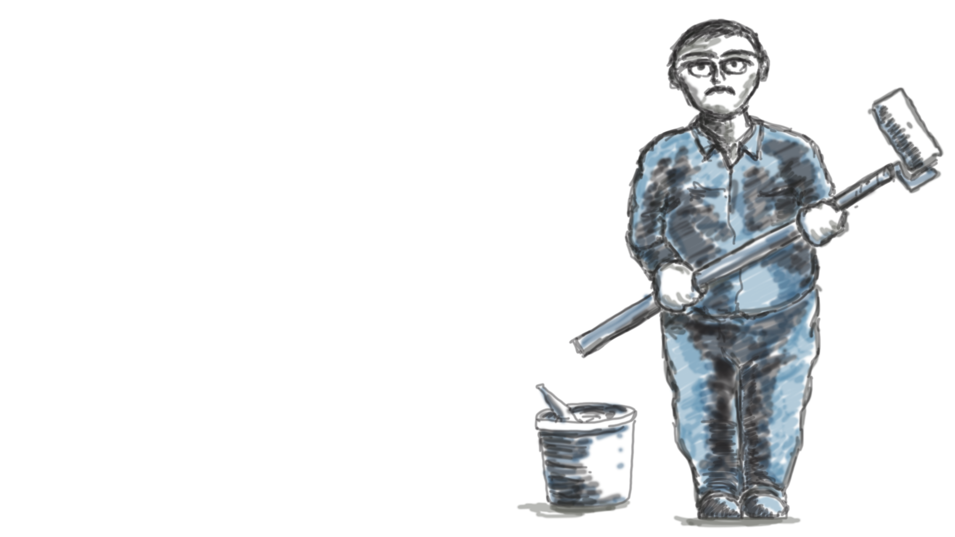
Painter
Enemy Painter: this enemy goes around and paints over areas player has colorized.
Paints the areas and brings back to a grey scale.

Slide 9
Power-ups
Power-ups will vary from different objects.
There will be available a paint spray can
There are various different items to distract the enemy.
Food for distraction.
“Paint Bombs” or paint buckets to distract enemies.

Slide 10
Potential power-ups
Added skateboard/roller blades to increase speed to traverse the grid
Whistle cause noise distraction
More to come.

Slide 11
Game controls & user interface
The game is set on a grid like map.
The user can use keyboard or mouse to move the characters. Movement would be used with the standard WASD, or mouse clicks to move the character.
Power-ups will be used with the numbers 1, 2, 3 or 4 or mapped to specified location.
The main game play screen will be composed of a pause, exit or options.

Slide 12
Monetization
This game is free to play

Slide 13
Replayability
Option to beat high scores
More maps available for play
Currently there is no sequel in mind, and no further progression on the game.
Updates may also include more power-ups

Slide 14
Inspirations & examples
Game design was inspired by Pac-man and bomber man arcade style games.

Slide 15
Asset list
Character Design. Multiple different characters
Management of light in textures
Background sounds (city environment)
Character Sounds.
Background Music, (hip-hop music, progressive, jazzy)
Several Characters available for use, multiple character designs.
Character Animations required for transition throughout the grid/map

Slide 16
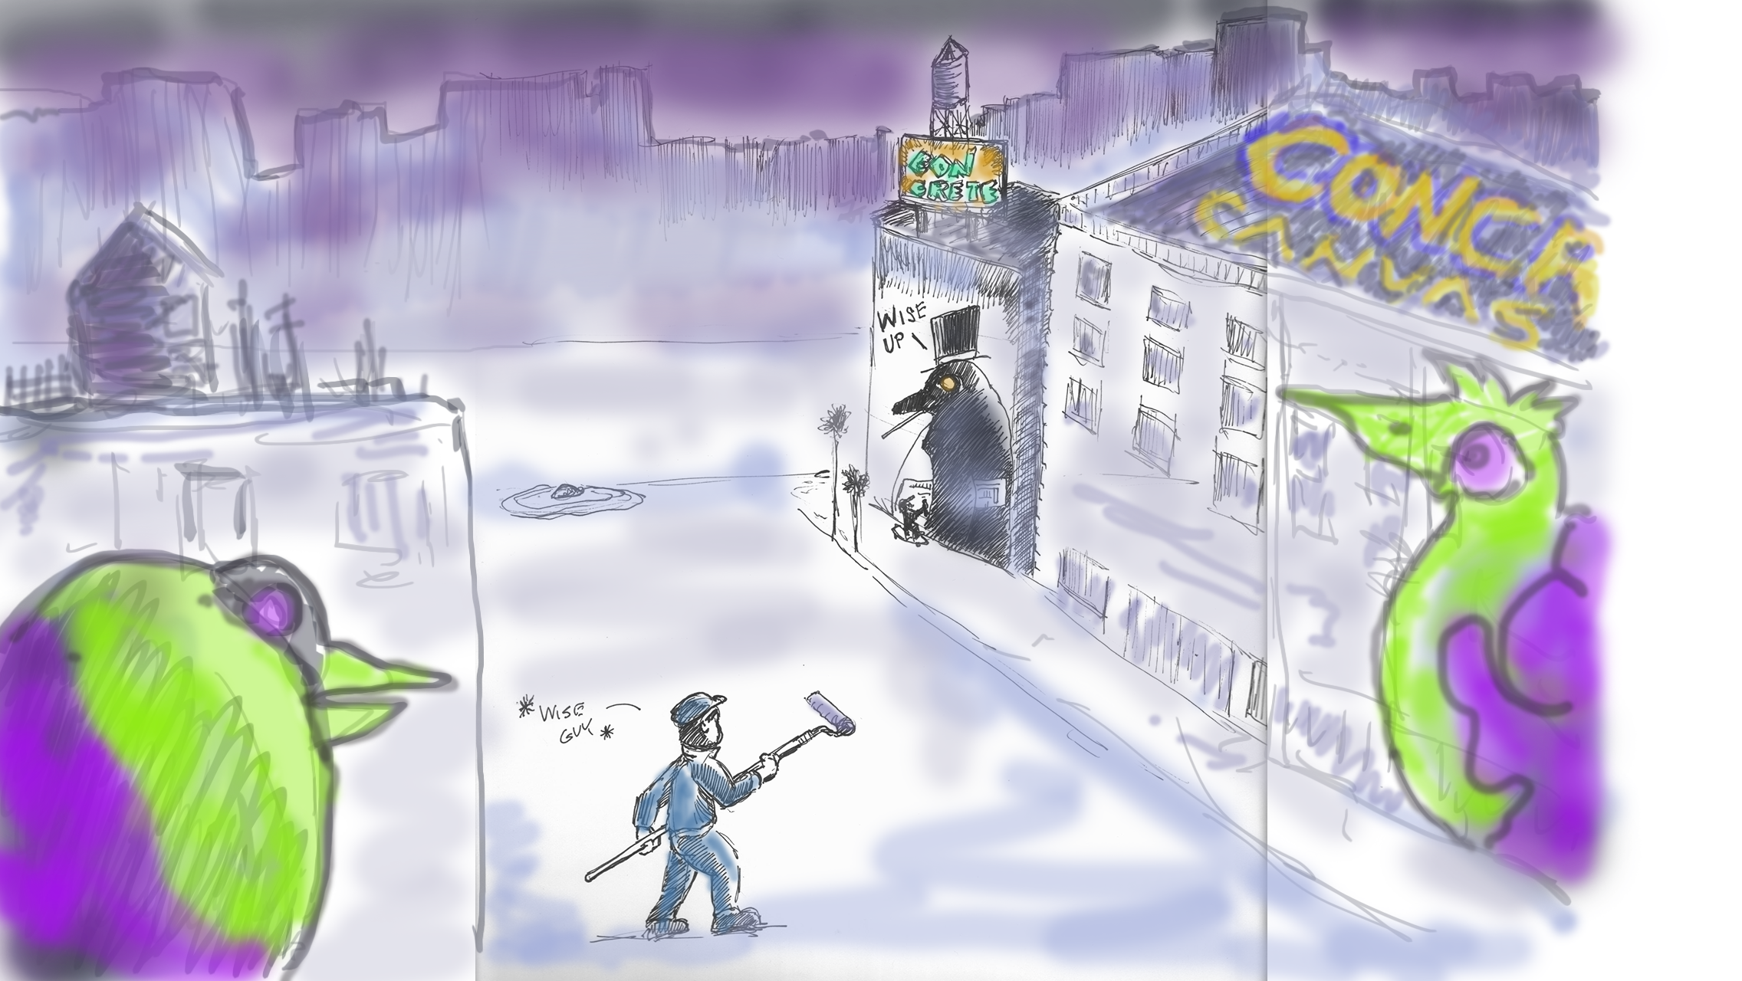
Concept art

Slide 17
Artist
Arman Davari
Ryan Johal
Joaquin Junco Jr.
Joe Posadas

Slide 18
Game developers
Joe Carlos De Almeida Machado
Leonardo Molina
Adrian Osuna
Lawrence Thai

Slide 19
Music composer
Jaelyn Denise

